Slide 1
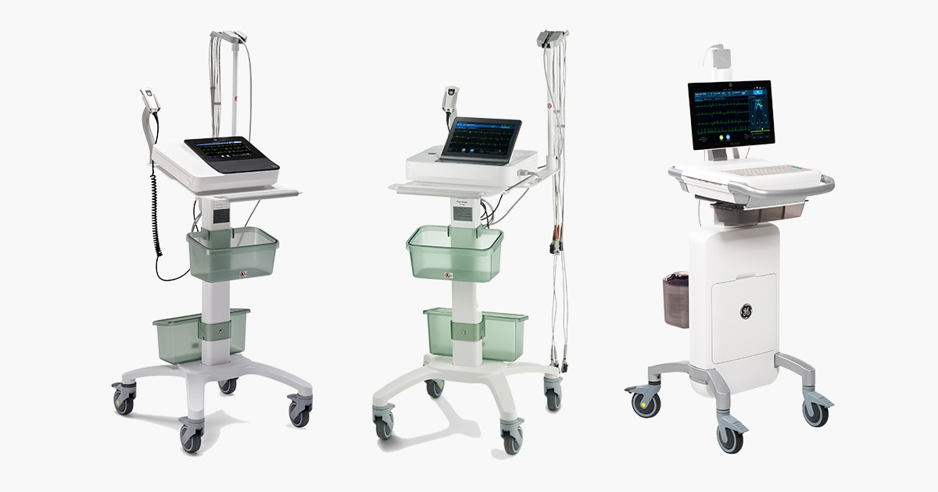
ECG MACHINE
Thamothiraj v
BE –Bio Medical Engineering

Slide 2
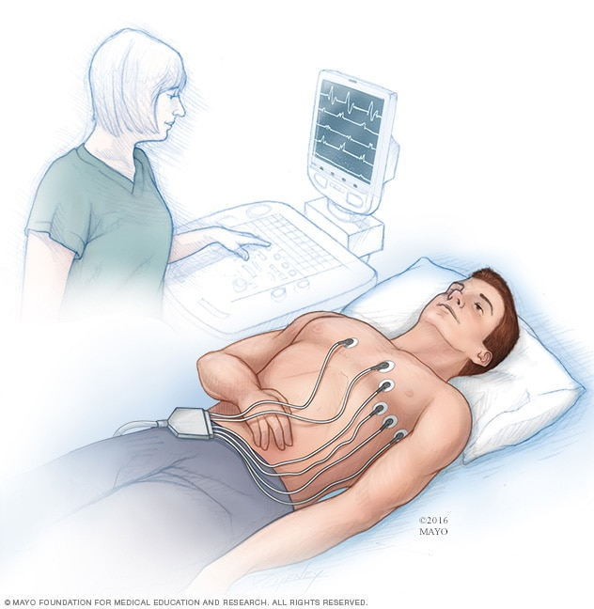
What is an ECG ?
ECG stands for electrocardiogram (also called EKG).
The device can detect the electrical activity of the heart are real time period
ECG machine was diagnostic device it was recorded by the electrical activity of the heart and mainly detected the abnormality in heart rhythms in the rate
A normal resting heart rate is 60 to 100 beats per minute (bpm)

Slide 3
Working principle
Heart produces electrical impulses during contraction and relaxation.
ECG machine detects these impulses using electrodes.
Electrical signals are amplified and recorded as a waveform.
The waveform represents one cardiac cycle.
Action potential = Graphical representation

Slide 4
Working Procedure
Preparation: The patient lies still on an examination table, typically removing clothing from the waist up. Shaving of chest hair may be necessary for proper electrode contact.
Electrode Placement: A technician attaches 10-12 electrodes to the skin, typically placed on the limbs and specific, precise locations on the chest. These do not send electricity into the body.
Recording the ECG: The electrodes are connected to an ECG machine via lead wires. The machine records the heart's electrical impulses as they travel through the heart muscle, displaying them as waveforms on a screen or printer
Completion: After about 10 seconds of active recording, the electrodes are removed, and the patient can immediately return to normal activity.

Slide 5
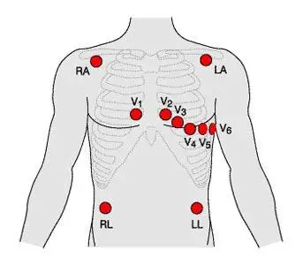
ECG electrode placement
Limb Electrodes
RA (Right Arm): The Right Shoulder And Wrist
(red)color
LA (Left Arm): The Left Shoulder And Wrist
(Yellow)color
RL (Right Leg): Below The Right Torso (Often Used As Ground) (Black)color
LL (Left Leg): Below The Left Torso (Green)color

Slide 6
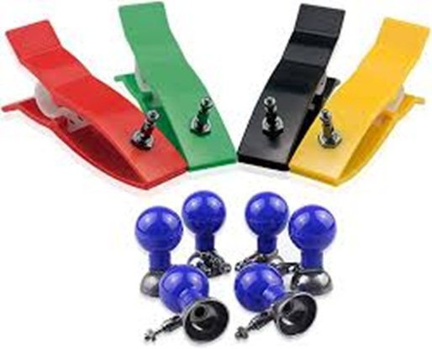
Electrode Colours
V1: Place on the 4th intercostal space on the right side of the sternum (red)
V2: Place on the 4th intercostal space on the left side of the sternum (yellow)
V3: Place exactly midway between V2 and V4 (green)
V4: Place on the 5th intercostal space along the mid-clavicular line (blue)
V5: Place on the 5th intercostal space along the anterior axillary line (front of the armpit) (orange)
V6: Place on the 5th intercostal space along the mid-axillary line (middle of the armpit) (purple)

Slide 7
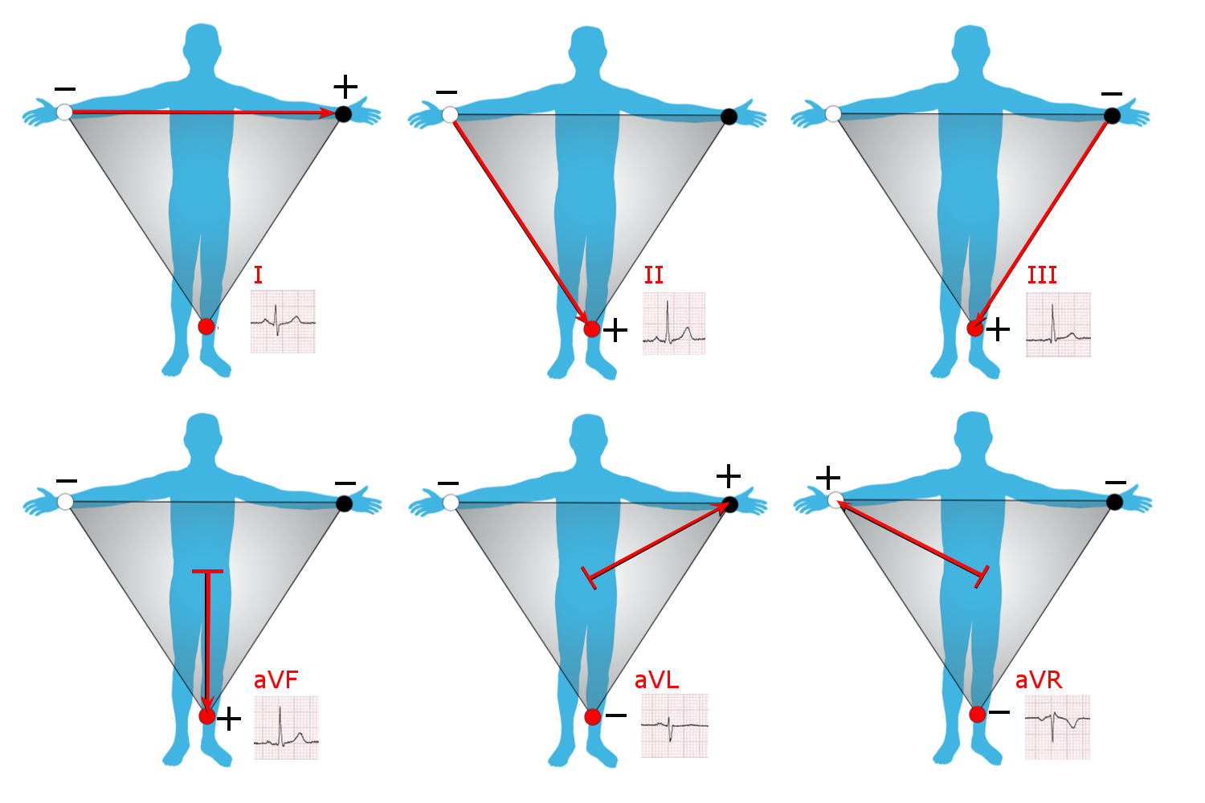
Einthoven’s triangle
Points of the triangle
aVR – Augmented Voltage Right arm
aVL – Augmented Voltage Left arm
aVF – Augmented Voltage Foot (Left leg)
The three bipolar limb leads
Lead I: LA – RA
Lead II: LL – RA
Lead III: LL – LA

Slide 8
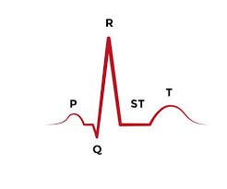
Understanding the ECG Waveform
• P wave: Atrial depolarization
• QRS complex: Ventricular depolarization
• T wave: Ventricular repolarization
• PR interval, ST segment, QT interval – diagnostic markers

Slide 9
Advantages
Early detection of heart issues
Identifies arrhythmias, heart attacks, and other cardiac abnormalities before symptoms escalate
Real-time monitoring
Enables continuous observation of heart activity during surgery, in ICUs, or during stress tests.
Supports diagnosis and treatment planning
Helps doctors make informed decisions about medication, procedures, or lifestyle changes.
Fast and efficient
Results are available within minutes, ideal for emergency situations.

Slide 10
Disadvantages
• False positives and negatives
abnormal traces may not reflect clinical disease, and some conditions remain undetected.
• Requires correct electrode placement
misplacement causes misleading waveforms.
• Signal artefacts
patient movement, muscle tremor, poor skin contact, or electrical interference distort readings.

Slide 11
Common problems faced during ECG recording
Muscle tremor (EMG noise)
Patient movement, shivering, or talking causes irregular spikes and noisy ECG trace.
Poor electrode contact
Dry gel, loose electrodes, or dirty skin leads to weak or disturbed signal.
Baseline wander
Caused by breathing, body movement, or loose leads — ECG baseline shifts up and down.
Motion artifacts
Patient movement or cable pulling produces sudden abnormal waves.
Wrong lead placement
Incorrect electrode position gives wrong ECG interpretation and false diagnosis.
Sweat or oily skin increases resistance and reduces signal quality.

Slide 12
MAKE | MODEL
GE | Mac 5 Mac 2000
Nihon Kohden | Ecg-2350
Philips | Tc 20

Slide 13
THANK YOU

